Slide 1
A bite size template
GUIDELINES IN PINK!
(remove before professional use)
Lars Rönnbäck
A title page with your name, additional company info, how to reach you, and other relevant information about you (not your topic).

Slide 2
“You can really only get one sentence across to your audience in five minutes.”
– Lars Rönnbäck
A one sentence summary which embodies what you are trying to get across to your audience. Think elevator pitch on steroids.

Slide 3
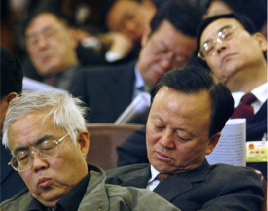
Research has shown that attendees normally only remember one of the many things said in a presentation.
People tend to get tired during long presentations, reducing their ability to listen carefully.
Rushing through your material will make everyone stressed, including you.
Use a few very simple images or bullet points to strengthen your previous statement (the one to remember). Keep it short. It’s better to have some breathing room than to run out of breath. Be extremely cautious of extending this over several slides, rather than one.

Slide 4
I’ll take your questions during the break!
Find a suitable visual that can end your presentation and stay on screen while the next presenter is getting ready. Don’t say much more than
“Thank you!” on this slide.

