Slide 1
Lost in Translation
Photos courtesy of The Artifice.
The database as a lofi documentation device
Lars Rönnbäck
lars.ronnback@anchormodeling.com
@anchormodeling
https://www.linkedin.com/in/ronnback/
http://www.anchormodeling.com/

Slide 2
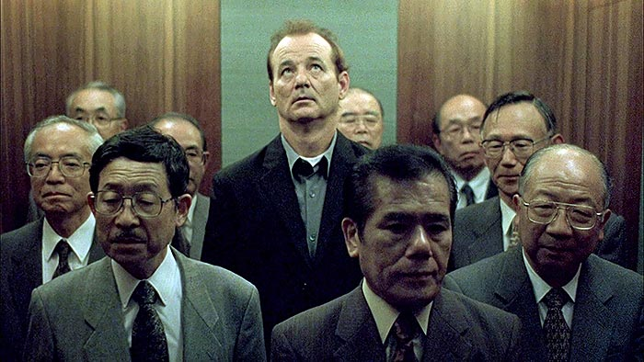
A database is never a source.

Slide 3
A database is never a source.
Me too is producing data.
I am producing data.
I am also producing data.

Slide 4
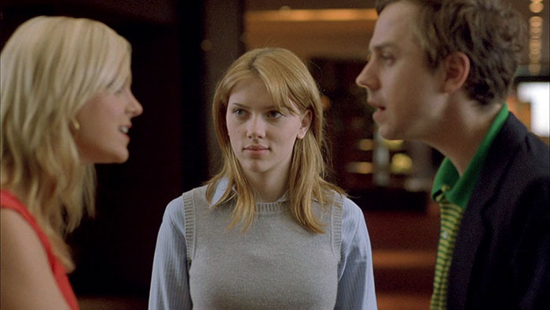
How do you document reality?

Slide 5
This is what I am experiencing.
I am saying something important here...
I am hearing something else.
How do you document reality?

Slide 6
How do you reconstruct reality?

Slide 7
Based on my experience, this is my interpretation of the data.
Based on my experience this is my interpretation of what you are saying...
How do you reconstruct reality?

Slide 8
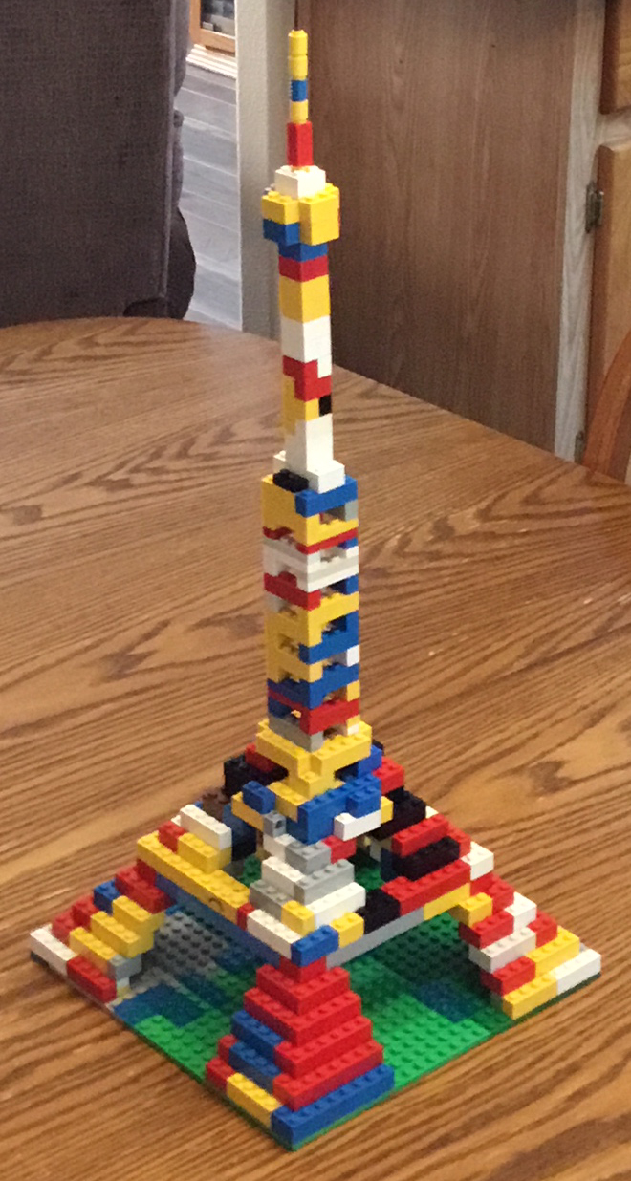
MENTAL
IMAGE
REALITY
DATABASE

Slide 9
MENTAL
IMAGE
REALITY
documentation
loss of fidelity
reconstruction
may gain fidelity
DATABASE

Slide 10
We do our best with the building blocks we have!
MENTAL
IMAGE
REALITY
documentation
loss of fidelity
reconstruction
may gain fidelity
DATABASE

Slide 11
We do our best with the building blocks we have!
MENTAL
IMAGE
REALITY
documentation
loss of fidelity
reconstruction
goes horribly wrong
DATABASE

Slide 12
SYNTAX
CONTEXT
EVALUATION

Slide 13
SYNTAX
In order to put context into syntax we need to do a subjective and local evaluation.
In order to get context from syntax we need to do a subjective and local evaluation.
CONTEXT
EVALUATION

Slide 14
SYNTAX
This is lasting.
In order to put context into syntax we need to do a subjective and local evaluation.
In order to get context from syntax we need to do a subjective and local evaluation.
CONTEXT
EVALUATION
This is real.
This is human.

Slide 15
SYNTAX
This is lasting.
In order to put context into syntax we need to do a subjective and local evaluation.
In order to get context from syntax we need to do a subjective and local evaluation.
CONTEXT
EVALUATION
DATA
SCIENCE
INFORMATION
THEORY
KNOWLEDGE
MANAGEMENT
This is real.
This is human.

Slide 16
SYNTAX
This is lasting.
In order to put context into syntax we need to do a subjective and local evaluation.
In order to get context from syntax we need to do a subjective and local evaluation.
CONTEXT
EVALUATION
DATA
SCIENCE
INFORMATION
THEORY
MODEL
KNOWLEDGE
MANAGEMENT
This is real.
This is human.

Slide 17
SYNTAX
This is lasting.
In order to put context into syntax we need to do a subjective and local evaluation.
In order to get context from syntax we need to do a subjective and local evaluation.
THE EXPERTISE OF A DATA MODELER
CONTEXT
EVALUATION
DATA
SCIENCE
INFORMATION
THEORY
MODEL
KNOWLEDGE
MANAGEMENT
This is real.
This is human.

