Slide 1
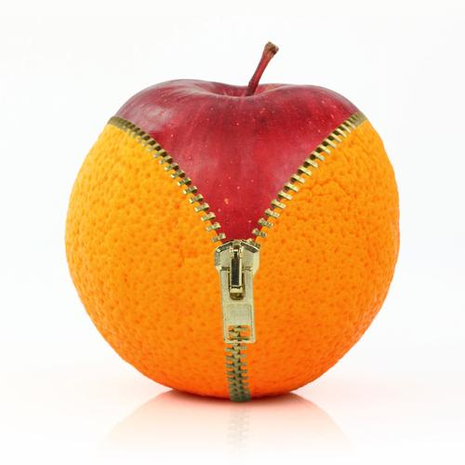
Are apples and oranges
two different concepts, derived from fruit?
Or are apples and oranges
variations of a single concept,
distinguishable as types of fruit?
FRUIT
FRUIT
is a
is a
has a
APPLE
ORANGE
TYPE
{Apple, Orange}
The answer will be given by Lars Rönnbäck
in the presentation ”It’s High Time for Bottom Up”
at the Knowledge Gap 2021.

