Slide 1
Are there aliens on the FAR side of the moon?
A DATA WAREHOUSE QUESTION
Lars Rönnbäck

Slide 2
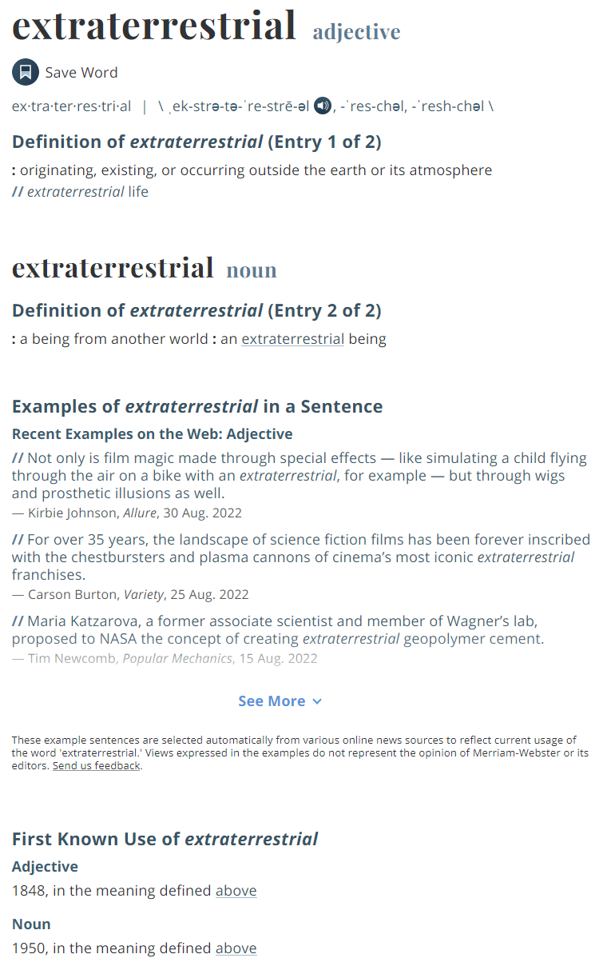
UNDERSTAND THE QUESTION
Alien lifeform according to AI: DALL-E

Slide 3
The moon is rotating at exactly the right speed for the same side to always face earth.
Tidal locking
Publik animering från NASA's Scientific Visualization Studio

Slide 4
UNDERSTAND THE ANSWER
Are there aliens on the far side of the moon?
NO

Slide 5
UNDERSTAND THE ANSWER
Are there aliens on the far side of the moon?
NO
The moon actually has a far side.

Slide 6
UNDERSTAND THE ANSWER
Are there aliens on the far side of the moon?
NO
The moon actually has a far side.
There is no evidence that aliens exists at all.
Astronauts have seen the far side of the moon with their naked eyes.
Unmanned satellites have photographed the far side.

Slide 7
UNDERSTAND THE ANSWER
Are there aliens on the far side of the moon?
NO
The moon actually has a far side.
There is no evidence that aliens exists at all.
Astronauts have seen the far side of the moon with their naked eyes.
Unmanned satellites have photographed the far side.
Those who claim to have been abducted by aliens are liars.

Slide 8
UNDERSTAND THE ANSWER
Are there aliens on the far side of the moon?
NO
The moon actually has a far side.
There is no evidence that aliens exists at all.
Astronauts have seen the far side of the moon with their naked eyes.
Unmanned satellites have photographed the far side.
Those who claim to have been abducted by aliens are liars.
The Apollo program was not a fake.
Statments made by astronauts like William Anders are credible.
Aliens are not invisible.
Statements made under oath are always true.
NASA is a credible institution.

Slide 9
UNDERSTAND THE ANSWER
Are there aliens on the far side of the moon?
NO
The moon actually has a far side.
There is no evidence that aliens exists at all.
Astronauts have seen the far side of the moon with their naked eyes.
Unmanned satellites have photographed the far side.
Aliens are not photograph repellant.
The cameras were in proper working condition.
Those who claim to have been abducted by aliens are liars.
Nobody has tampered with the photographs.
The Apollo program was not a fake.
The development process works as intended.
Statments made by astronauts like William Anders are credible.
Aliens are not invisible.
The negatives were handled correctly.
Statements made under oath are always true.
NASA is a credible institution.

Slide 10
UNDERSTAND THE ANSWER
Are there aliens on the far side of the moon?
NO
The moon actually has a far side.
There is no evidence that aliens exists at all.
Astronauts have seen the far side of the moon with their naked eyes.
Unmanned satellites have photographed the far side.
Aliens are not photograph repellant.
The cameras were in proper working condition.
Those who claim to have been abducted by aliens are liars.
Nobody has tampered with the photographs.
The Apollo program was not a fake.
The lenses did not aberrate away anything.
The development process works as intended.
Statments made by astronauts like William Anders are credible.
The physics of lenses is well understood.
Aliens are not invisible.
The negatives were handled correctly.
Statements made under oath are always true.
NASA is a credible institution.
Light consists of photons.

Slide 11
UNDERSTAND THE ANSWER
Are there aliens on the far side of the moon?
NO
The moon actually has a far side.
There is no evidence that aliens exists at all.
Astronauts have seen the far side of the moon with their naked eyes.
Unmanned satellites have photographed the far side.
Aliens are not photograph repellant.
The cameras were in proper working condition.
Those who claim to have been abducted by aliens are liars.
Nobody has tampered with the photographs.
The Apollo program was not a fake.
The lenses did not aberrate away anything.
The development process works as intended.
Statments made by astronauts like William Anders are credible.
The physics of lenses is well understood.
Aliens are not invisible.
The negatives were handled correctly.
Statements made under oath are always true.
NASA is a credible institution.
NETWORK OF TRUST
Light consists of photons.

Slide 12
UNDERSTAND THE ANSWER
Are there aliens on the far side of the moon?
NO
The moon actually has a far side.
There is no evidence that aliens exists at all.
Astronauts have seen the far side of the moon with their naked eyes.
Unmanned satellites have photographed the far side.
Aliens are not photograph repellant.
The cameras were in proper working condition.
Those who claim to have been abducted by aliens are liars.
Nobody has tampered with the photographs.
The Apollo program was not a fake.
The lenses did not aberrate away anything.
The development process works as intended.
Statments made by astronauts like William Anders are credible.
The physics of lenses is well understood.
Aliens are not invisible.
The negatives were handled correctly.
Statements made under oath are always true.
NASA is a credible institution.
NETWORK OF TRUST
Light consists of photons.
and it is deep...

Slide 13
Are there aliens on the far side of the moon?
Public domain image by Thirdman at pexels.com.

Slide 14
Source 1
Evaluation
Deliberation
Are there aliens on the far side of the moon?
Source 2
Evaluation
Source 3
Evaluation
Opinion
Source 4
Evaluation
Source 5
Evaluation

Slide 15
Source 1
Evaluation
Deliberation
Are there aliens on the far side of the moon?
Often enough to provide quick answers.
Source 2
Evaluation
Source 3
Evaluation
Opinion
Source 4
Evaluation
Source 5
Evaluation

Slide 16
Source 1
Evaluation
Deliberation
Are there aliens on the far side of the moon?
Often enough to provide quick answers.
Source 2
Evaluation
Source 3
Evaluation
Reliable
Opinion
Source 4
Evaluation
Source 5
Evaluation
PERSONAL
THOROUGH PREPATORY WORK

Slide 17
ERP
Data flow
Integration
How many monthly active customers have we got?
Often enough to provide quick answers.
CRM
Data flow
PoS
Data flow
Data Warehouse
web
Data flow
external
Data flow
JOINT EFFORT
THOROUGH PREPATORY WORK

Slide 18
ERP
Data flow
Integration
How many monthly active customers have we got?
Often enough to provide quick answers.
CRM
Data flow
PoS
Data flow
Data Warehouse
web
Data flow
Is it a project?
external
Data flow
JOINT EFFORT
THOROUGH PREPATORY WORK

Slide 19
UNDERSTAND THE ANSWER
Reliability changes
Are there aliens on the far side of the moon?
NO
The moon actually has a far side.
There is no evidence that aliens exists at all.
Astronauts have seen the far side of the moon with their naked eyes.
Unmanned satellites have photographed the far side.
Aliens are not photograph repellant.
The cameras were in proper working condition.
Those who claim to have been abducted by aliens are liars.
Nobody has tampered with the photographs.
The Apollo program was a fake.
The lenses did not aberrate away anything.
The development process works as intended.
Statments made by astronauts like William Anders are credible.
The physics of lenses is well understood.
Aliens are not invisible.
The negatives were handled correctly.
Statements made under oath are always true.
NASA is a credible institution.
NETWORK OF TRUST
Light consists of photons.
and it is deep...

Slide 20
UNDERSTAND THE ANSWER
Reliability changes and the impact spreads in the network
Are there aliens on the far side of the moon?
NO
The moon actually has a far side.
There is no evidence that aliens exists at all.
Astronauts have seen the far side of the moon with their naked eyes.
Unmanned satellites have photographed the far side.
Aliens are not photograph repellant.
The cameras were in proper working condition.
Those who claim to have been abducted by aliens are liars.
Nobody has tampered with the photographs.
The Apollo program was a fake.
The lenses did not aberrate away anything.
The development process works as intended.
Statments made by astronauts like William Anders are credible.
The physics of lenses is well understood.
Aliens are not invisible.
The negatives were handled correctly.
Statements made under oath are always true.
NASA is a credible institution.
NETWORK OF TRUST
Light consists of photons.
and it is deep...

Slide 21
UNCERTAIN OF THE ANSWER
TRUST IS
ERODED
Reliability changes and the impact spreads in the network
Are there aliens on the far side of the moon?
Not so sure...
The moon actually has a far side.
There is no evidence that aliens exists at all.
Astronauts have seen the far side of the moon with their naked eyes.
Unmanned satellites have photographed the far side.
Aliens are not photograph repellant.
The cameras were in proper working condition.
Those who claim to have been abducted by aliens are liars.
Nobody has tampered with the photographs.
The Apollo program was a fake.
The lenses did not aberrate away anything.
The development process works as intended.
Statments made by astronauts like William Anders are credible.
The physics of lenses is well understood.
Aliens are not invisible.
The negatives were handled correctly.
Statements made under oath are always true.
NASA is a credible institution.
NETWORK OF TRUST
Light consists of photons.
and it is broken...

Slide 22
ERP
Data flow
Integration
How many monthly active customers have we got?
Often enough to provide quick answers.
CRM
Data flow
PoS
Data flow
Reliable Data Warehouse
web
Data flow
It is a process!
external
Data flow
JOINT EFFORT
THOROUGH ONGOING WORK

Slide 23
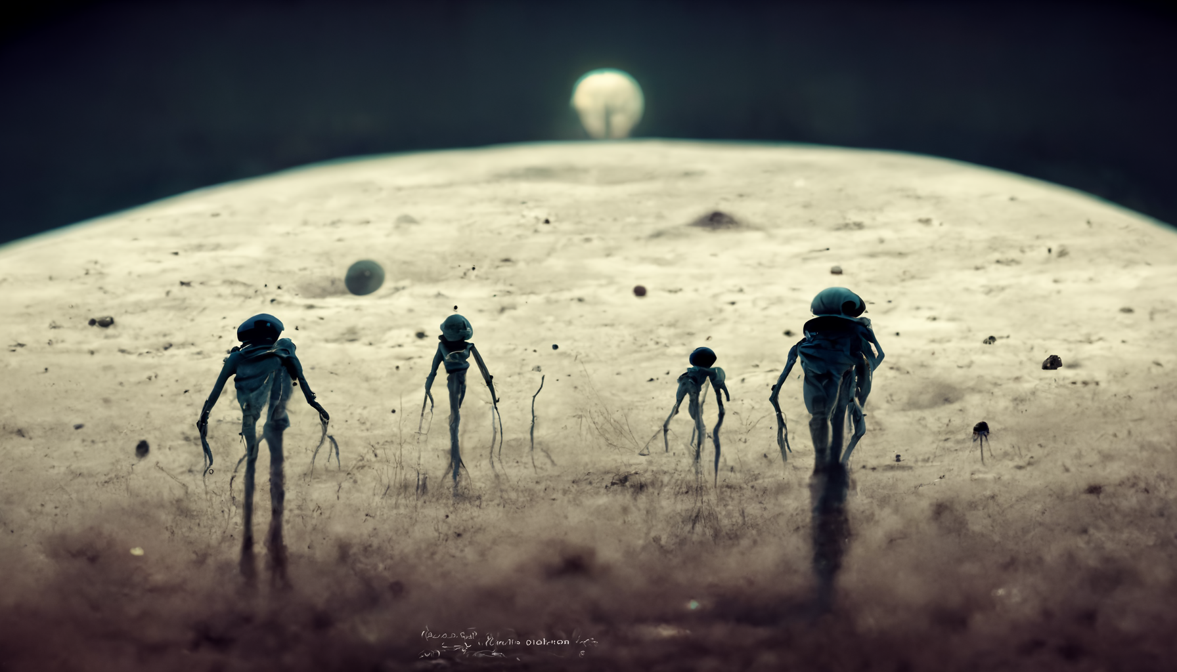
Are there aliens on the far side of the moon?
AI generated art from the prompt:
Aliens standing on the surface of the moon looking at the planet Earth
https://www.midjourney.com/

